Slide 1

Medallia Post Launch Observations on ODP Atmosphere
May 9, 2023

Slide 2
Atmosphere Medallia Observations
April 19th, 2023 – May 9th, 2023: Likelihood to Recommend Score
Objective: Research themes/topics that are trending since the launch (April 19, 2023) of Atmosphere.ca ODP.
Dataset: Tracking 46 comments.
Top Themes and Findings Summary
Positive Experience – Majority of users had a positive experience with the site(easy to navigate, good selection of products, etc.).
Product Availability – Some users expressed frustration with the inaccurate and unreliable product availability display.
Sub-Themes and Findings Summary
Website Changes Dislikes– Negative feedback regarding recent changes(“I like the old site vs new…”, harder to navigate, etc.).
Redeeming Triangle Points/Gift Cards – Customers are confused on how to redeem CT points to make purchases on the site.

Slide 3
Tracking Customer Feedback Themes by Occurrence

Slide 4
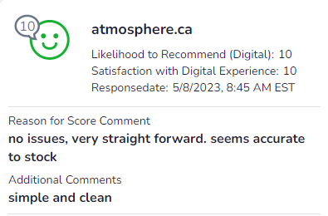
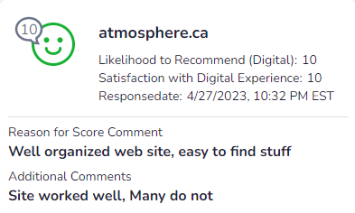
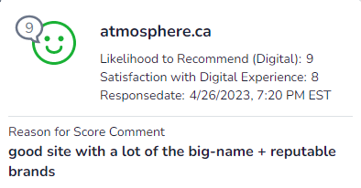
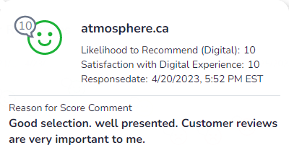
Positive Experience
Observation:
Majority of users find the site easy to navigate, good search functionalities, well-organized layout, good selection of products and brands, and appreciate customer reviews to inform their purchasing decisions.

Slide 5
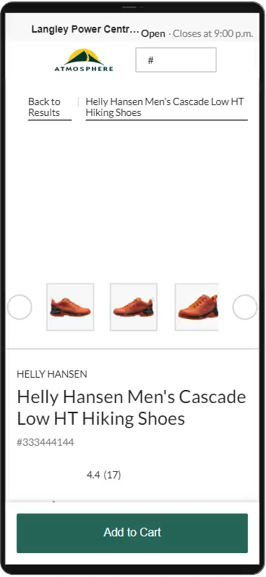
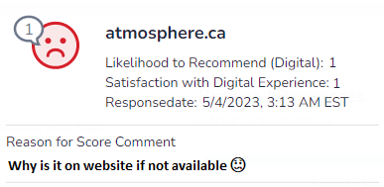
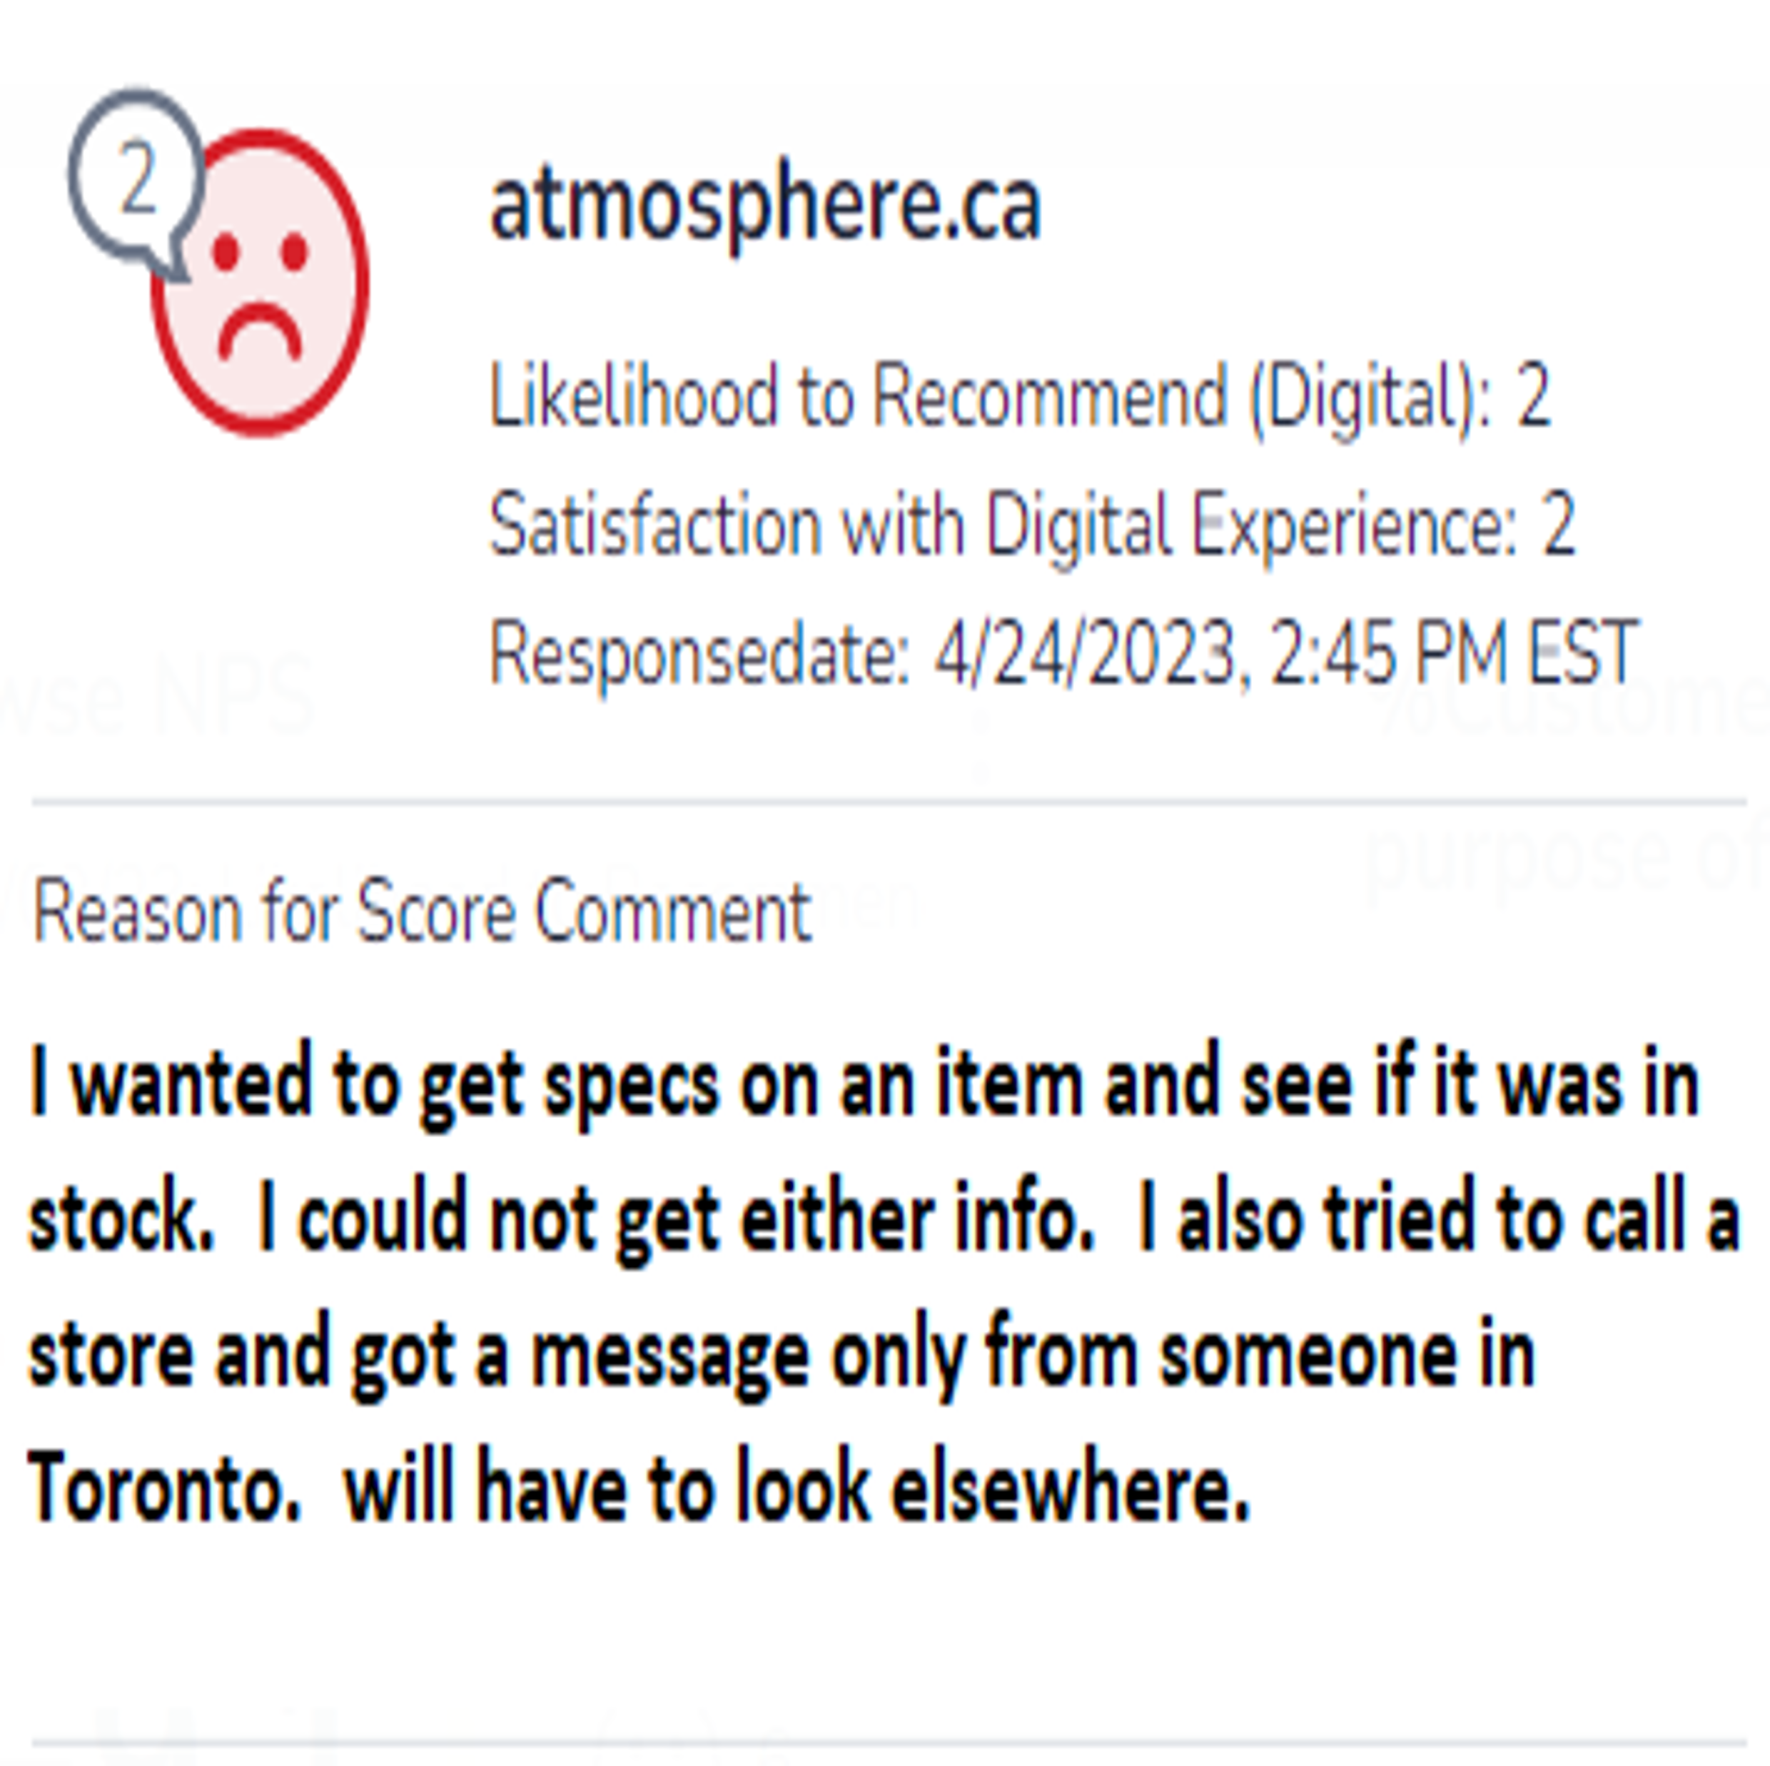
Product Availability
Notes
Customer tries multiple sizes that appear available and gets the message that item is out of stock (Known issue) [Full QM Session]
User experienced failure at multiple touch points of the omnichannel experience.
Observation:
Several comments indicated that the website fails to accurately depict the availability of products.

Slide 6
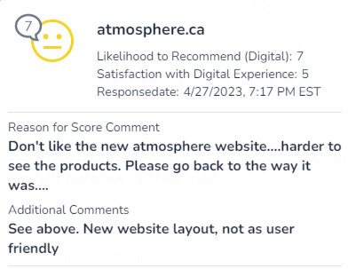
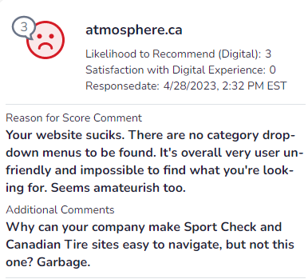
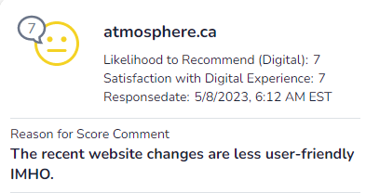
Sub-Theme:
Website Changes Dislikes
Observation:
Users expressed negative feedback regarding recent changes, including reduced ease of navigation, unappealing visuals, absence of category dropdown menus, and a decreased visibility of products.

Slide 7
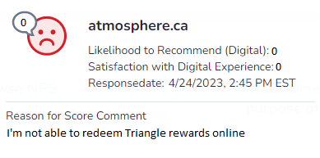
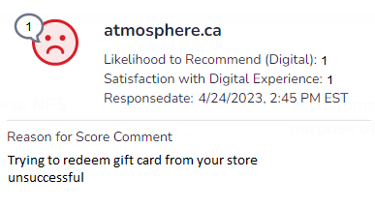
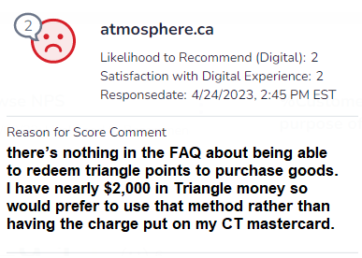
Sub-theme: Redeeming Triangle Points
Notes
This user failed to find instructions on how to redeem CT money.
Observation: The website doesn’t provide easy to find instructions on how to redeem CT money at checkout. This is resulting in a growing number of users experiencing difficulties in successfully finalizing their purchases.

Slide 8
Appendix

Slide 9
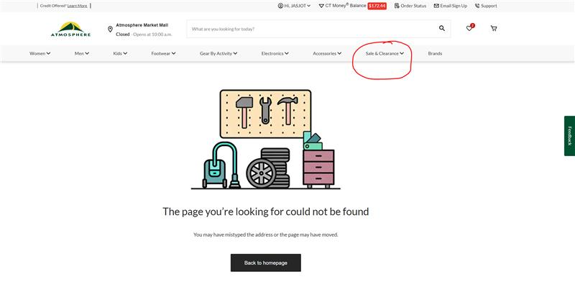
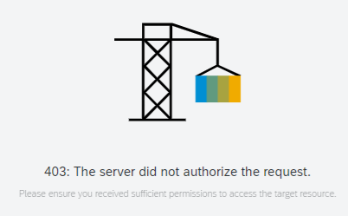
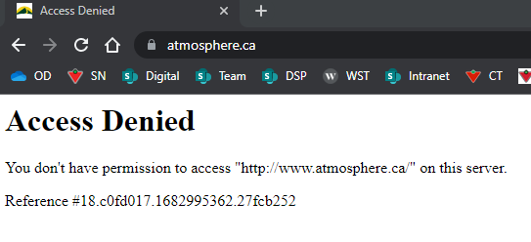
Sub-Theme: Technical Issues
Observation: Multiple incidents have been reported regarding technical issues, including “Access Denied”, 404/403 error messages, and broken links that occur when attempting to click on the "Sales & Clearance" link. This has been addressed by the eComm team on May 2nd, 2023.
Customer comments | Notes
“Poor stock of items and technical issues with app freezing up and slow loading.” | [Full QM session] This video show the user’s experiencing slow loading or frozen screens, at multiple points.
“Website doesn’t work”

Slide 10
Other Negative Experiences
Customer comments
“Your guy's pricing is ridiculous. Your competitors are way more affordable, and the quality is the same.”
“Good: selection, sale prices Poor: completeness and accuracy of product descriptions”

